Slide 1
Exchanging Predictive Models
PMML Support for Gaussian Process Regression
Max Ferguson
04/28/15

Slide 2
Outline
Background
Predictive Models
Training and Testing
Industry Adoption
Exchanging Models
PMML Introduction
Gaussian Processes
MATLAB Gaussian Process Package
Looking to the Future
Open Repository for Models
Google Scoring Machine

Slide 3
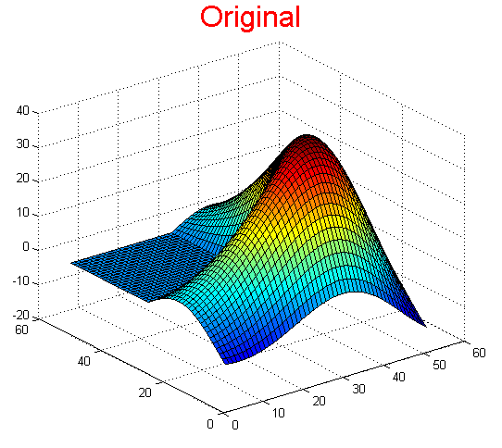
Background
PMML AND Gaussian Process Regression

Slide 4

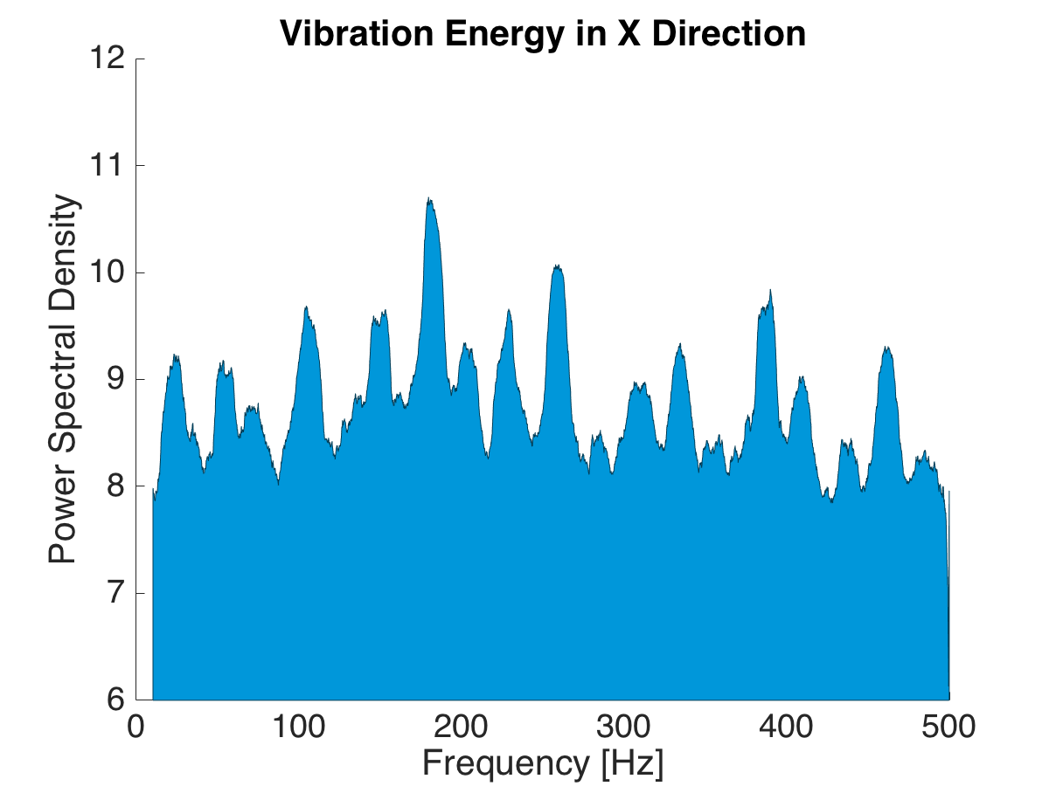
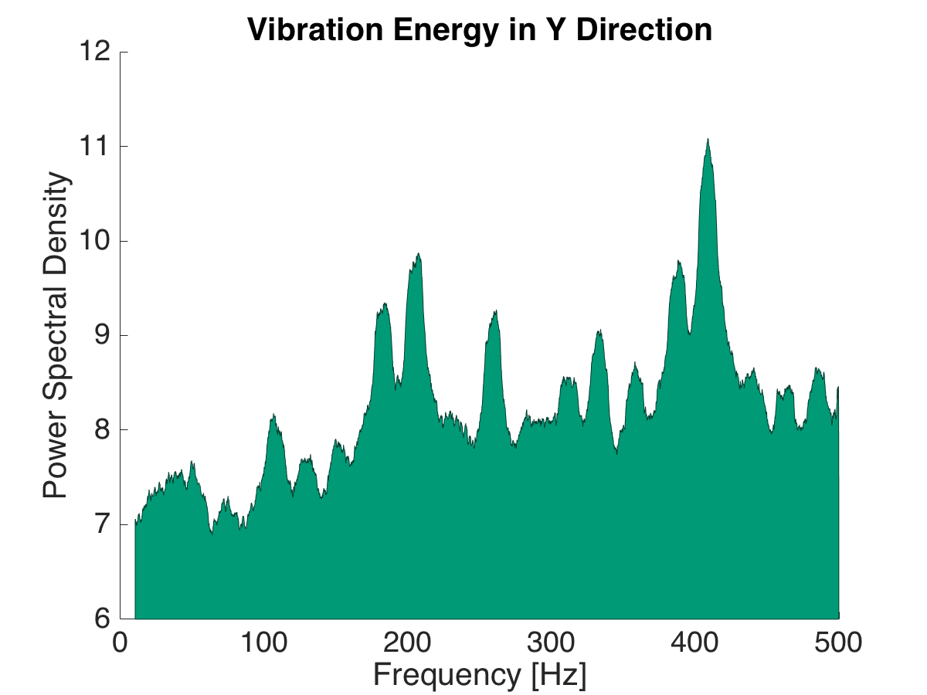
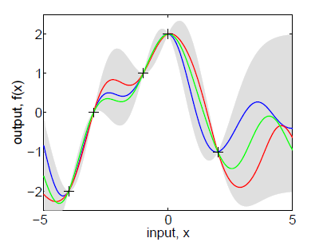

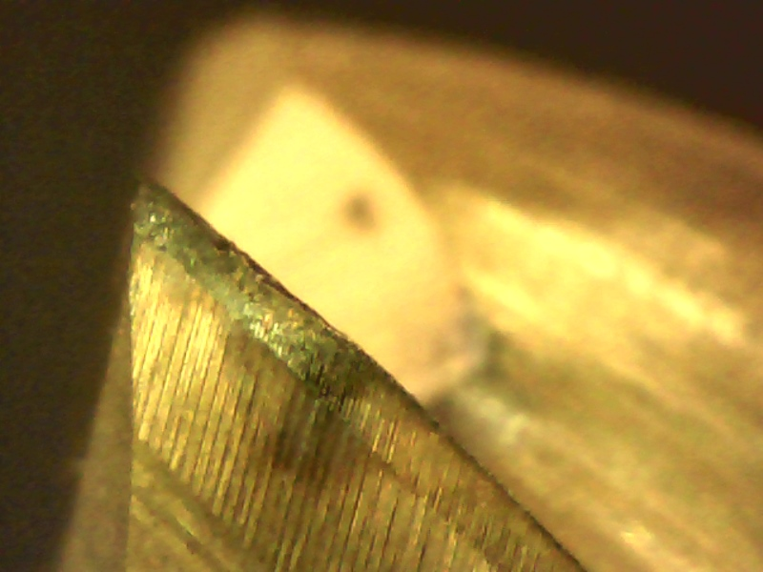
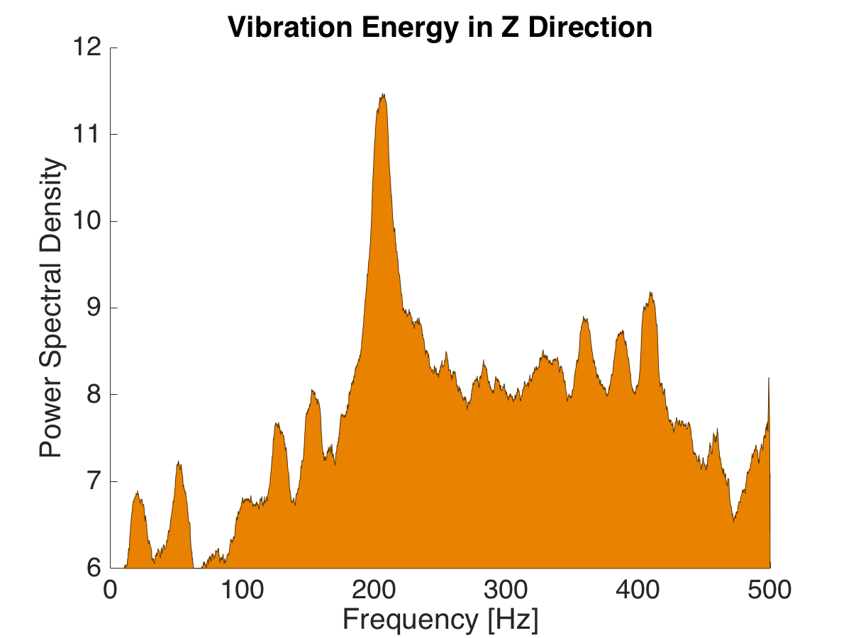
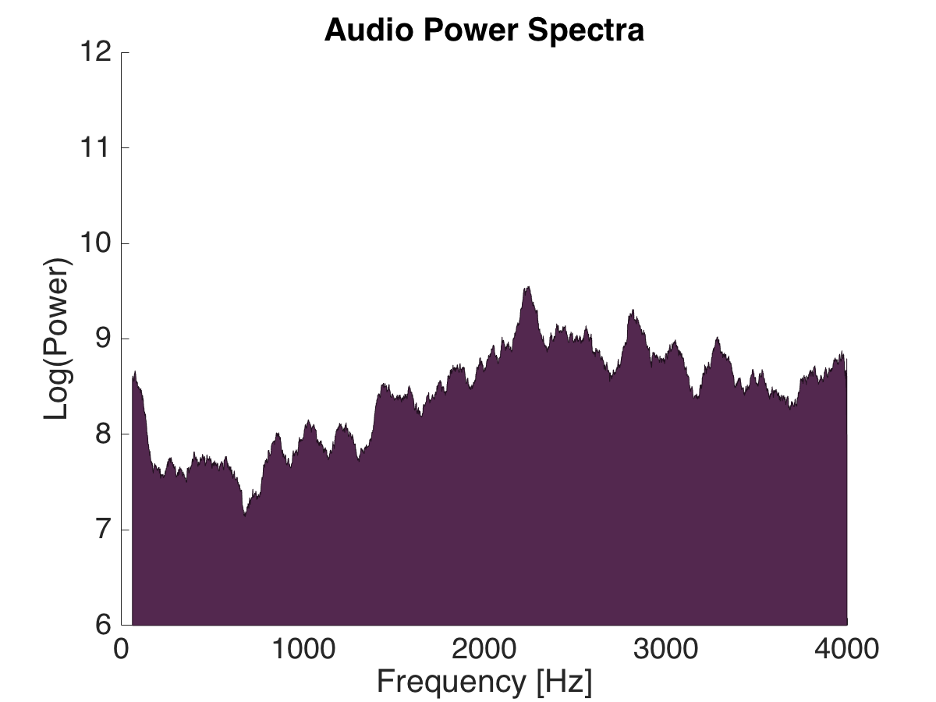
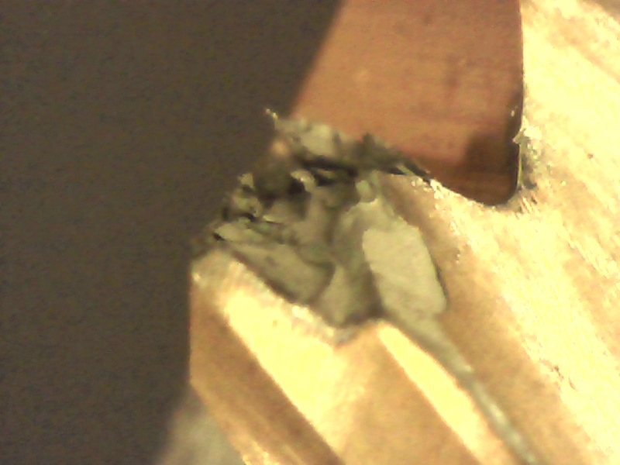
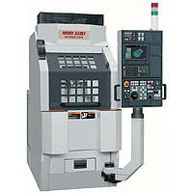
Predictive Models
✓
-
x
Predictive Model
Trained using previous (known) data
Make predictions based on input values
Are becoming increasingly powerful

Slide 5
Model Training
Data Collection
Collect a large amount of data
Process and featurize the data
Choose a Model Type
Linear Regression
Gaussian Process Regression
Support Vector Machine
Training
Fit the model to the data
Optimization algorithms are normally used
Cross validate the model
Data Collection
Filtering
Featurization
Training
Cross validation

Slide 6
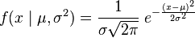


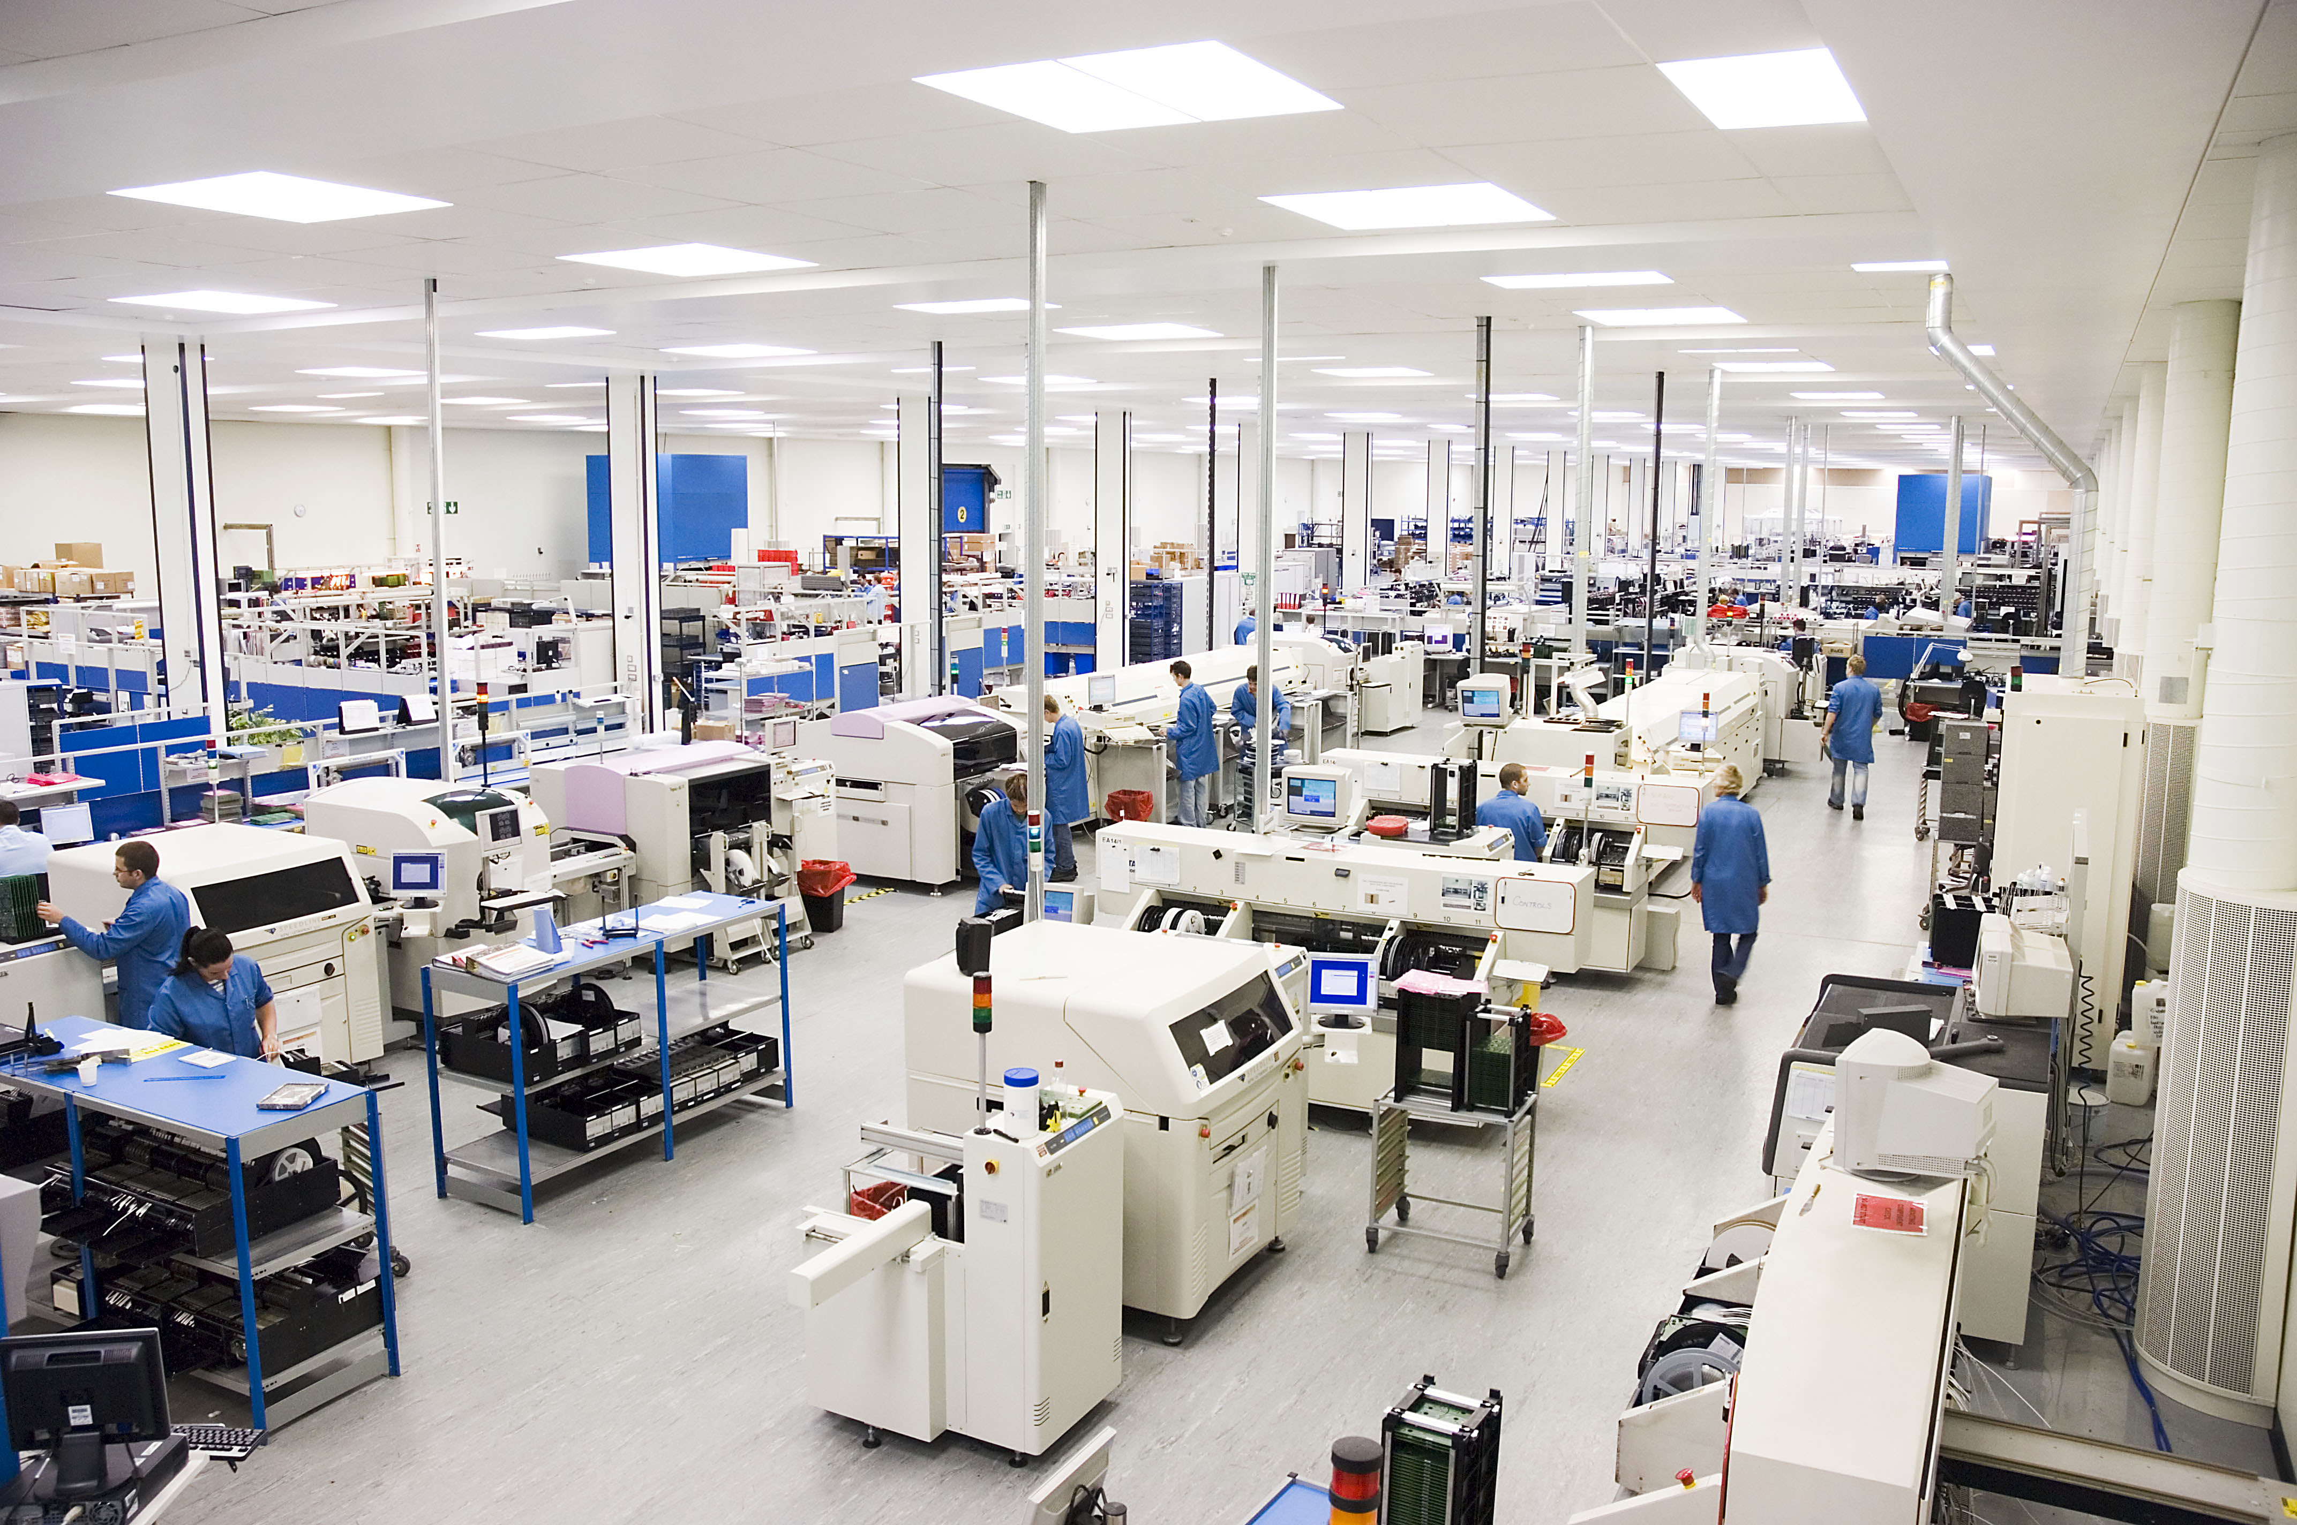
Industry Adoption
1990 – 2000: Huge advances in predictive modeling theory
2000 – 2010: Computational power is sufficient to justify advanced predictive models
2010 – 2015: Predictive modeling is used by major advertising networks
2015 – 2016: Google, Amazon and Microsoft release predictive modeling platforms
2020: Predictive modeling will be embedded in billions of devices

Slide 7
Industry Adoption
Predictive models for manufacturing are being created in research labs and universities right now
How can these models be used by the industry?
How can these models be transferred from one person to another?
How do we load the trained models onto a machine?

Slide 8

Predictive Model Markup Language (PMML)
PMML AND Gaussian Process Regression

Slide 9
Introduction to PMML
PMML is the leading standard for representing statistical and data mining models
Developed by the Data Mining Group (DMG)
Supported by over 20 Vendors and applications
Contributions from numerous major players
NIST
NASA
Open Data Group (ODG)
Stanford University

Slide 10
Example PMML File
<?xml version="1.0" encoding="UTF-8"?>
<pmml xmlns="http://www.dmg.org/PMML-4_3" version="4.3">
<header copyright="DMG.org" />
<datadictionary numberoffields="32">
<datafield datatype="double" name="x1" optype="continuous" />
<datafield datatype="double" name="x2" optype="continuous" />
<datafield datatype="double" name="y1" optype="continuous" />
</datadictionary>
<gaussianprocessmodel functionname="regression" modelname="Gaussian Process Model">
<miningschema>
<miningfield name="x1" usagetype="active" />
<miningfield name="x2" usagetype="active" />
<miningfield name="y1" usagetype="predicted" />
</miningschema>
<output>
<outputfield datatype="double" feature="predictedValue" name="MeanValue" optype="continuous" />
<outputfield datatype="double" feature="predictedValue" name="StandardDeviation" optype="continuous" />
</output>
<ardsquaredexponentialkernel gamma="0.15651" noisevariance="0.004691">
<lambda>
<array n="31" type="real">1.451760 1.555283 0.939452</array>
</lambda>
</ardsquaredexponentialkernel>
<traininginstances fieldcount="32" istransformed="false" recordcount="725">
<instancefields>
<instancefield column="x1" field="x1" />
<instancefield column="x2" field="x2" />
<instancefield column="y1" field="y1" />
</instancefields>
<inlinetable />
</traininginstances>
</gaussianprocessmodel>
</pmml>

Slide 11
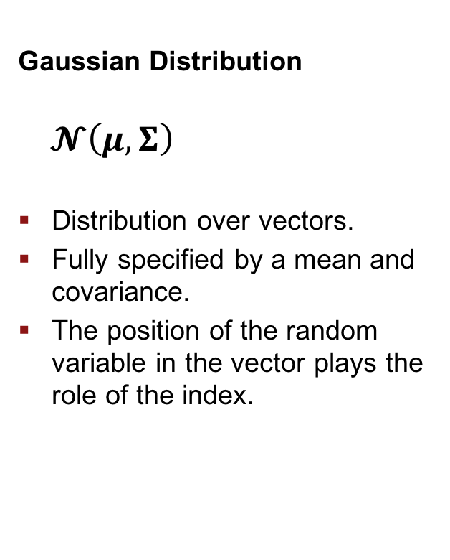
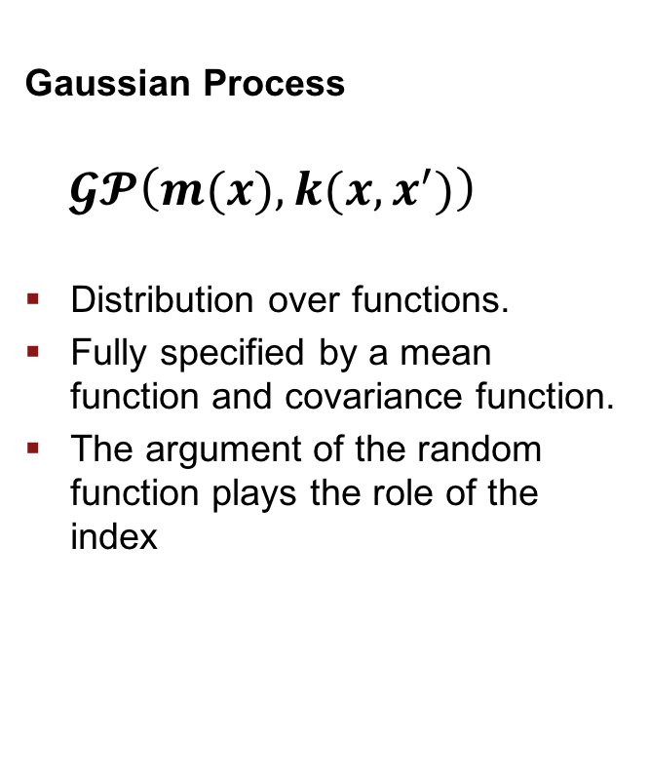
Gaussian Process Regression Model
Gaussian Distribution
$$𝓝\left(μ,Σ\right)$$
Distribution over vectors.
Fully specified by a mean and covariance.
The position of the random variable in the vector plays the role of the index.
Gaussian Process
$$𝓖𝓟\left(m(x),k(x,x^{′})\right)$$
Distribution over functions.
Fully specified by a mean function and covariance function.
The argument of the random function plays the role of the index

Slide 12
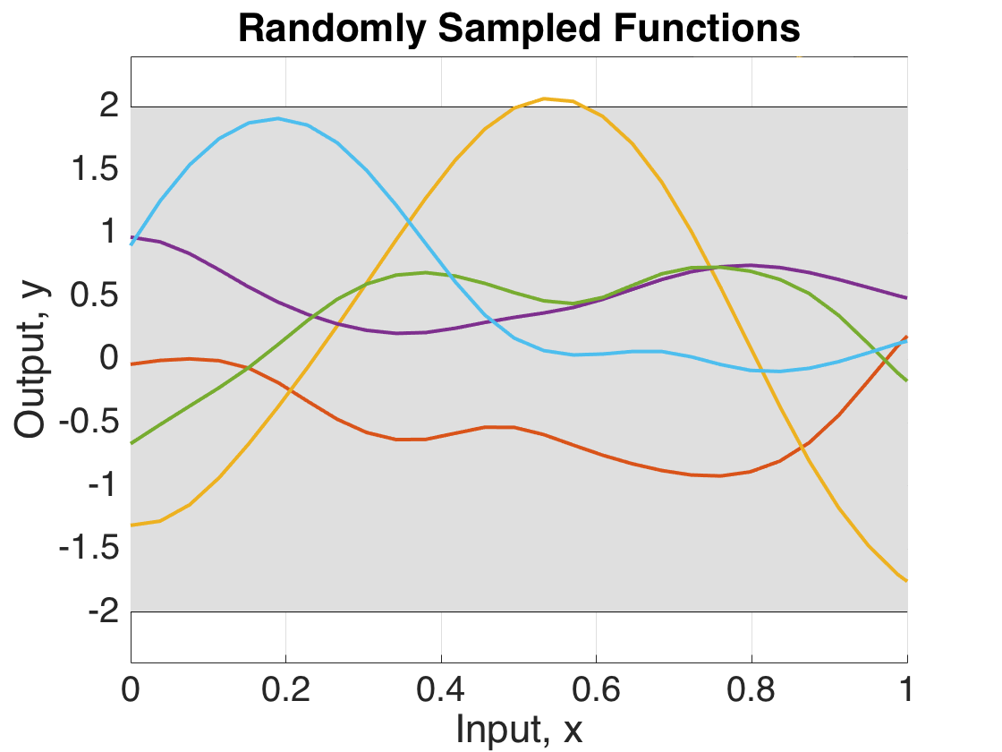
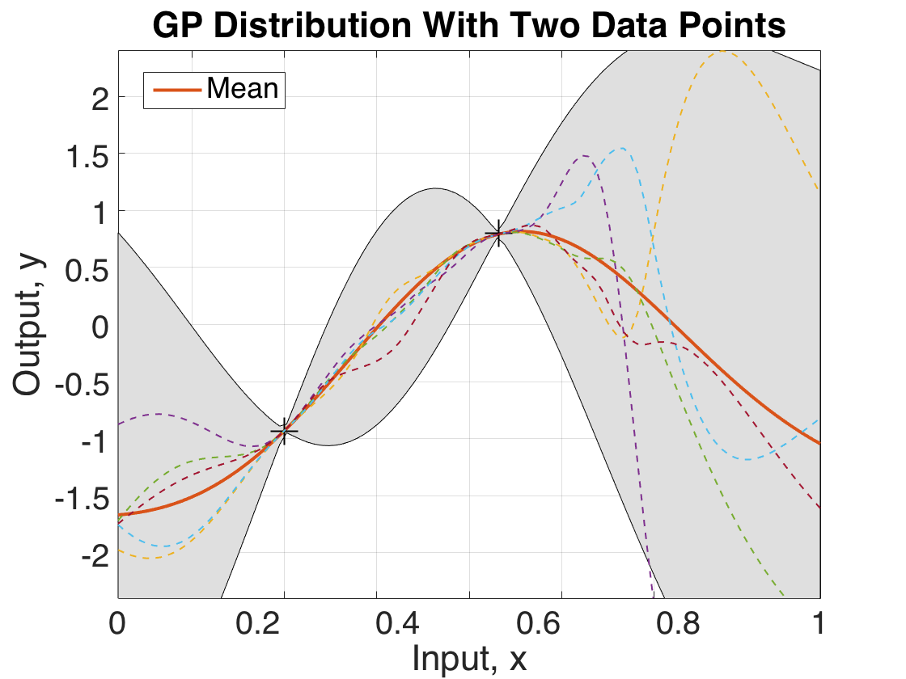
Gaussian Process Regression Model
Covariance function defines the properties in the function space.
Data points ”anchor” the function as specific locations.

Slide 13

Gaussian Process PMML Package
Implemented in MATLAB and Python
Converts trained Gaussian Process Model to PMML
Allows predictions to be made from PMML file

Slide 14

Looking to the Future
PMML AND Gaussian Process Regression

Slide 15
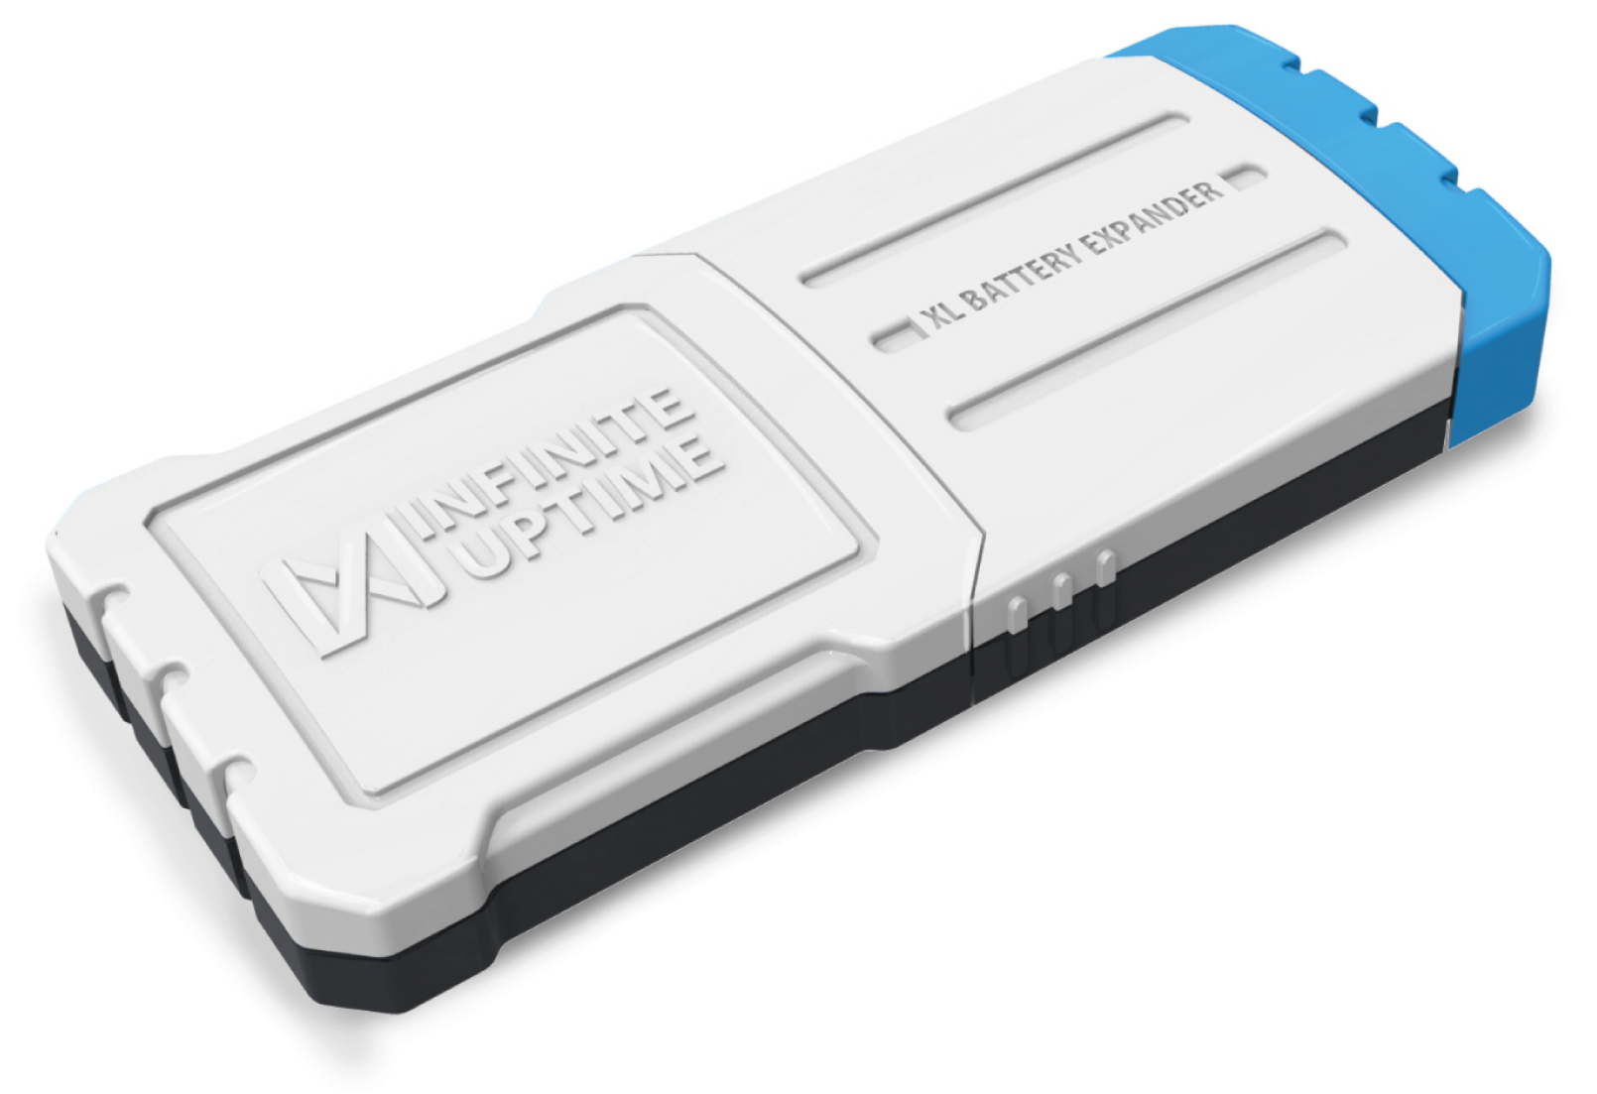
Exploring PMML Applications
Load PMML model onto a smart sensor (C++)
Leverage the power of the cloud: make predictions using the Google Machine Learning Engine
Publish our tool wear and energy consumption models

Slide 16
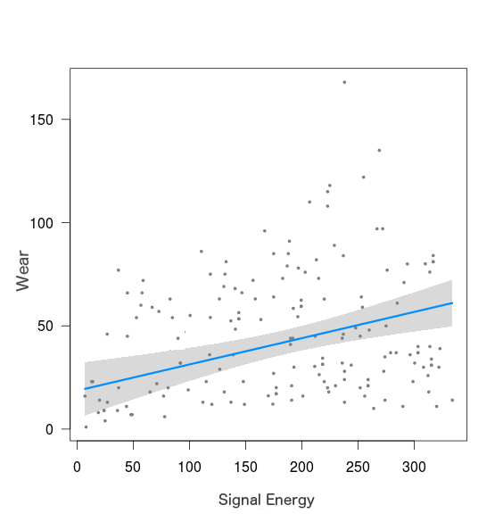
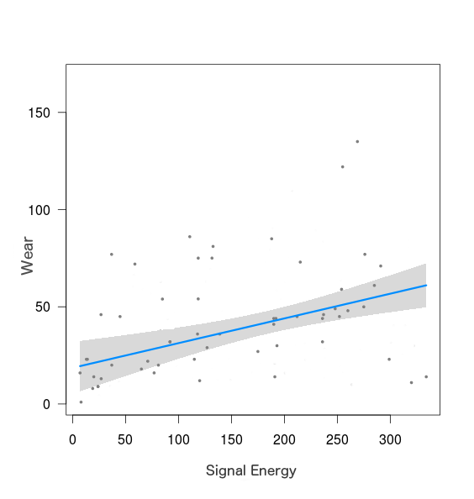
Sparse Gaussian Process PMML Package
Reduce file size by excluding data that is not needed
Results in much faster predictions
Better for Online Learning

Slide 17
Sharing Models with Industry
?????

Slide 18
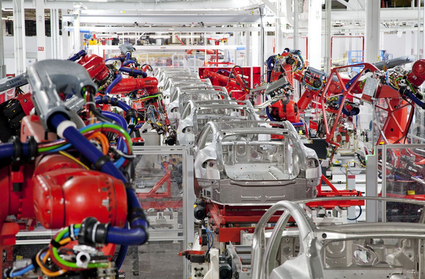
Questions?
PMML AND Gaussian Process Regression

